Slide 1
Query Processing Part II
CS- 212
Distributed Database Systems
Ms. Mariam Nosheen
Computer Science Department, LCWU, Lhr

Slide 2
Outline of todays Presentation
Query Processing
Data Localization
Conclusion
Ms. Mariam Nosheen
CS- 212 Distributed Database Systems

Slide 3
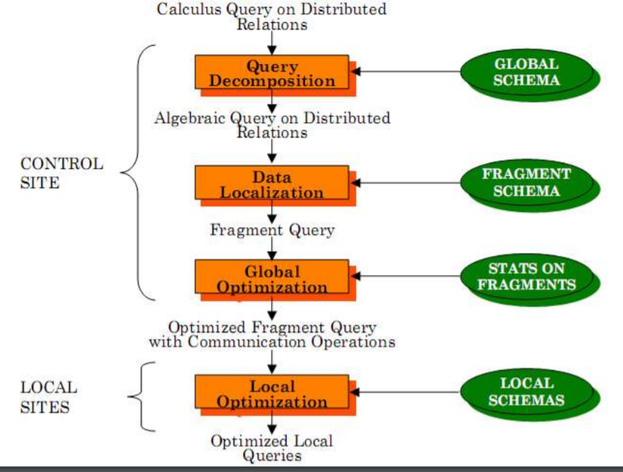
Layer 2 – Data Localization
Query Processing
Input: Algebraic query on distributed relations
Determine which fragments are involved
Localization program
➠ substitute for each global query its materialization program
➠ optimize
Ms. Mariam Nosheen
CS- 212 Distributed Database Systems

Slide 4
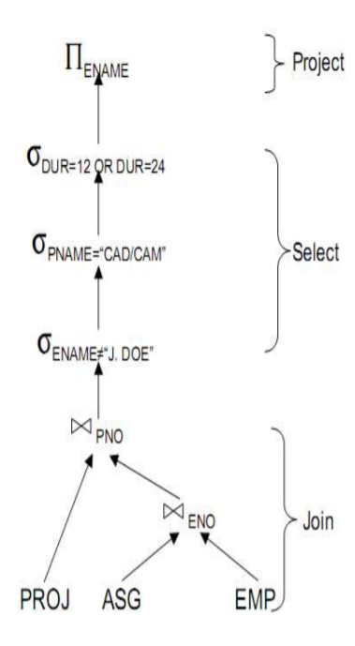
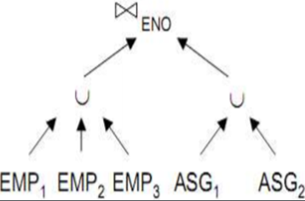
Example
Query Processing
Assume
➠ EMP is fragmented into EMP1, EMP2, EMP3
as follows:
EMP1=σENO≤“E3”(EMP)
EMP2= σ“E3”<ENO<“E6”(EMP)
EMP3=σENO≥“E6”(EMP)
➠ ASG fragmented into ASG1 and ASG2 as follows:
ASG1=σENO≤“E3”(ASG)
ASG2=σENO>“E3”(ASG)
Replace EMP by (EMP1∪EMP2∪EMP3 )
and ASG by (ASG1 ∪ ASG2) in any query
Ms. Mariam Nosheen
CS- 212 Distributed Database Systems

Slide 5
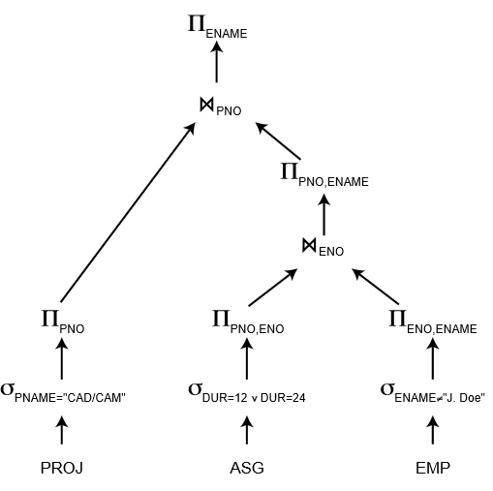
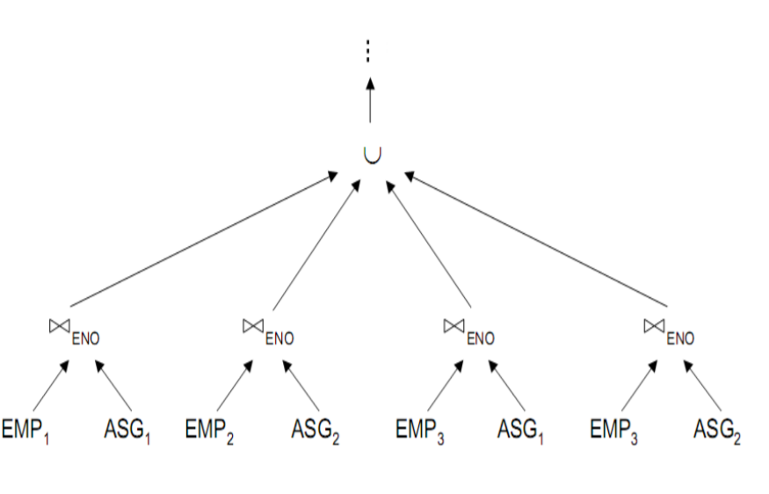
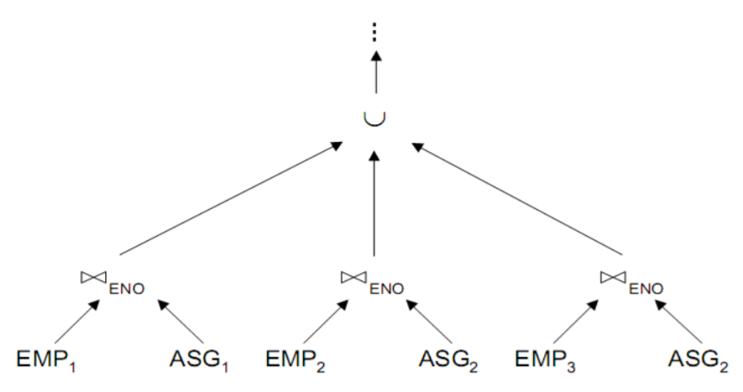
Reduce Query
Query Processing
Eliminates Unnecessary Work
Reduce Query
Rewritten Operator Tree
Ms. Mariam Nosheen
CS- 212 Distributed Database Systems

Slide 6
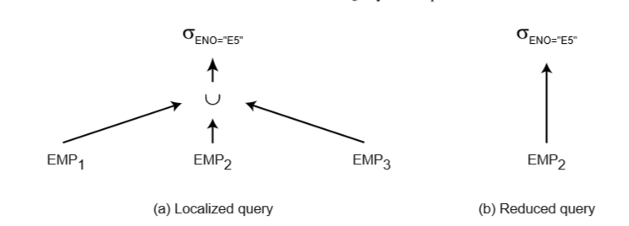
Layer 2 – Data Localization
Query Processing
Reduction for Primary Horizontal Fragmentation
Example
Relation EMP(ENO, ENAME, TITLE)
can be split into three horizontal fragments EMP1, EMP2, and EMP3, deﬁned as follows:
EMP1 = σENO≤”E3”(EMP)
EMP2 = σ”E3”<ENO≤”E6”(EMP)
EMP3 = σENO>”E6”(EMP)
a) Reduction with Selection
Example :We now illustrate reduction by horizontal fragmentation using the following example query:
SELECT * FROM EMP WHERE ENO = "E5"
Ms. Mariam Nosheen
CS- 212 Distributed Database Systems

Slide 7
Layer 2 – Data Localization
Query Processing
Reduction for Primary Horizontal Fragmentation
b) Reduction with Join
Example : Assume that relation EMP is fragmented between EMP1, EMP2, and EMP3, as above, and that relation ASG is fragmented as
ASG1 = σENO≤”E3”(ASG)
ASG2 = σENO>”E3”(ASG)
EMP1and ASG1are deﬁned by the same predicate. Furthermore, the predicate deﬁningASG2 is the union of the predicates deﬁning EMP2 andEMP3. Now consider the join query SELECT * FROM EMP, ASG WHERE EMP.ENO = ASG.ENO
Ms. Mariam Nosheen
CS- 212 Distributed Database Systems

Slide 8
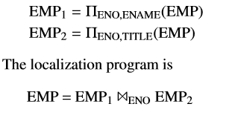
Layer 2 – Data Localization
Query Processing
Reduction for Vertical Fragmentation
The vertical fragmentation function distributes a relation based on projection attributes. Since the reconstruction operator for vertical fragmentation is the join, the localization program for a vertically fragmented relation consists of the join of the fragments on the common attribute. For vertical fragmentation, we use the following example.
Example : Relation EMP can be divided into two vertical fragments where the key attribute ENO is duplicated:
Ms. Mariam Nosheen
CS- 212 Distributed Database Systems

Slide 9
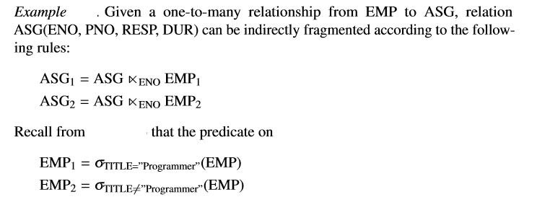
Layer 2 – Data Localization
Query Processing
Reduction for Derived Fragmentation
Ms. Mariam Nosheen
CS- 212 Distributed Database Systems

Slide 10
Layer 2 – Data Localization
Query Processing
Reduction for Hybrid Fragmentation
Ms. Mariam Nosheen
CS- 212 Distributed Database Systems

Slide 11
Conclusion
Query Processing
Ms. Mariam Nosheen
CS- 212 Distributed Database Systems

